Slide 1

“FOOD ORDERING SYSTEM”
Task - 2

Slide 2

FOOD ORDERING SYSTEM
It allows user to browse menus, select dishes, place order and pay for food from restaurant this system stream line the process, providing convenience to customers to make efficient order management for restaurants.
▪
LMS Username
Name
Batch
BARANI S
1
JEEVITHA G
1
KEERTHIGA M
1
NITHYA K
1

Slide 3
Step-Wise Description
Project Introduction:
Begin by introducing the project and its purpose . This system not only simplifies the ordering process for customers but also offers restaurants and efficient way to manage and fulfil orders.
Scope Definition:
The scope of a food ordering system can be detailed further to include specific features and functionalities such as User registration and profile, menu presentation, order placement , cart management , checkout and payment , order confirmation.

Slide 4
Functional Requirements: 1.Registration 2.Login 3.Display the menu 4.Modify menu 5.Select food items 6.Change the order 7.Review the order before submitting 8.Payment & Provide delivery
Testing Requirements:
The testing strategy, including functional, usability, performance, security, compatibility, integration, regression testing.

Slide 5
Summary of your task
A food ordering system is a digital platform that simplifies the process of ordering food from various restaurant it allow user to explore menus , select dished, customize order and securely place them for delivery or pick up.
Overall, this system revolutionizes the way people access and enjoy food, offering convenience and accessibility in the dining experience.

Slide 6
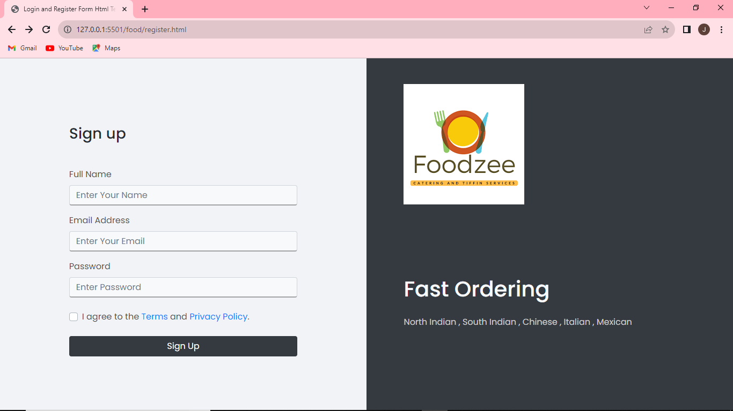

Slide 7

Submission Github
Insert Your Github Link Here

Slide 8


